Slide 1



Frédéric Gillardo
LAPP/IN2P3/CNRS
gillardo@lapp.in2p3.fr
Data Science
Notes:
Présentation : LAPP que savent-ils sur le lapp ?
Stage big data architect
Mon parcours professionnel
Un point sur eux
Python?
Anacoda?
Git?

Slide 2
CTA in a nutshell
Introduction to Data Science
Data science process
What is big data?
Data science steps
Acquiring Data
Exploring Data
Preprocessing Data
Analyse Data
Notes:
Supervision dans CTA
Présentation projet CTA
Protocole de supervision existant de HESS : OPC
Protocole de supervision dans CTA : OPCUA
Autres protocoles : Mqtt / RestAPi
Maintenance prédictive
industrie 4.0 exemple : EPCIS
Exemple de supervision informatique : Nagios

Slide 3

Multiwavelength Milky Way Images
Notes:
E=h*nu, E=h*c/lambda
Radiotelescope

Slide 4
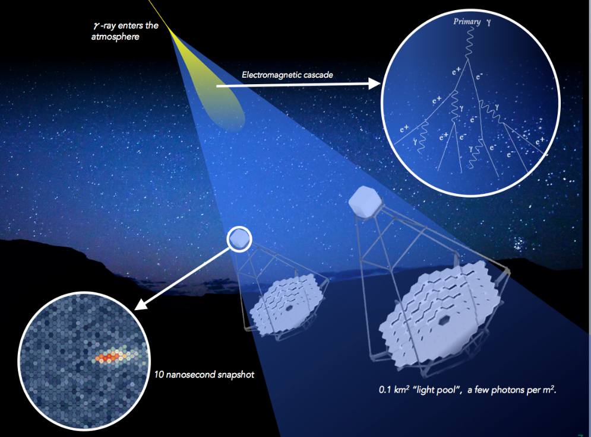
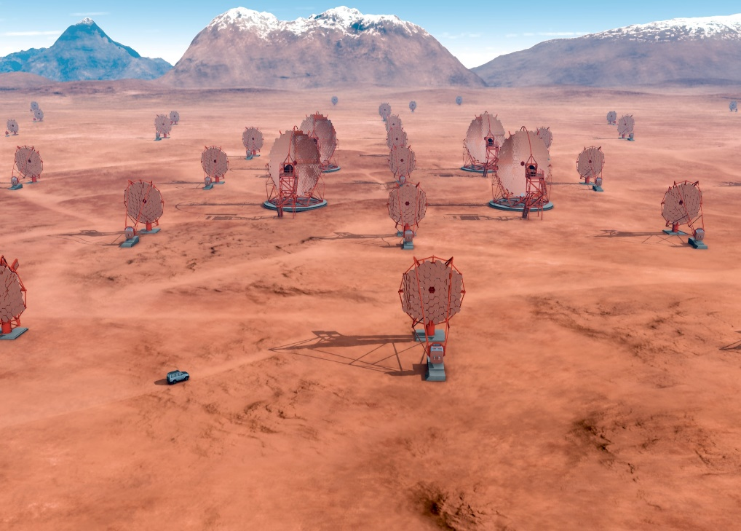
1. CTA in a nutshell
The Cherenkov Telescope Array (CTA) is the next generation ground-based observatory for gamma-ray astronomy at very-high energies. With more than 100 telescopes located in the northern and southern hemispheres, CTA will be the world’s largest and most sensitive high-energy gamma-ray observatory. Supernova, neutron start , pulsar, black hole, black matter
The gamma rays that CTA will detect do not make it all the way to the Earth’s surface. When they reach the Earth’s atmosphere they interact with it, producing cascades of very-high energy particles in the atmosphere creating a cone of blue “Cherenkov light”.
Notes:
Sud : centre galactique
rayon gamma cataclisme :
explosion d etoile :

Slide 5

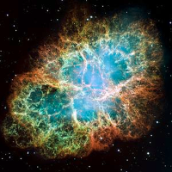
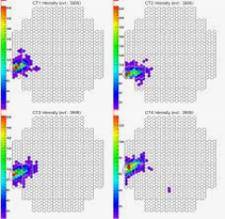
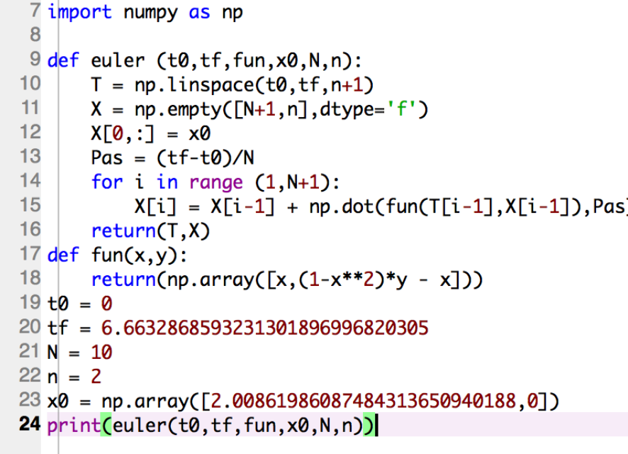
Introduction to Data Science
Data science process
Pattern recognition
Analysis
Insight/intuition
Notes:
Why big data now?
->digital verywhere / Bank, medical,
->gafa -> we are OK to be monitored
->more sensitive detector
->Some Public Data
-> standard format and API
->kaggle.com
Big data example:
Banque: Provide a loan rate
Medical diagnostic
Pregnant -> shop can learn it
Maintenance predictive
When you think aboyt the process there is nothing new: Same in science/ for baby when they learn

Slide 6
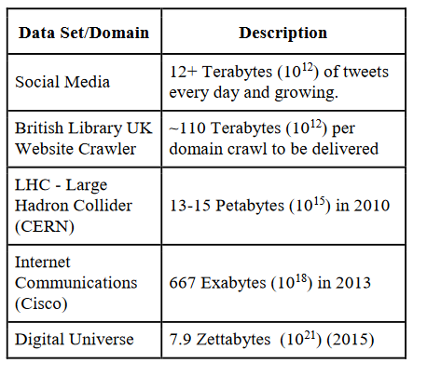
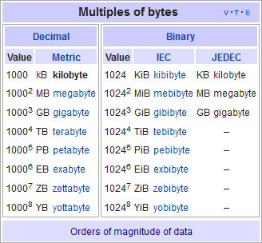
Introduction to Data Science
What is big data?
From wikipedia:
Big data usually includes data sets with sizes beyond the ability of commonly used software tools to capture, curate, manage, and process data within a tolerable elapsed time.^{[21]} Big data philosophy encompasses unstructured, semi-structured and structured data, however the main focus is on unstructured data.^{[22]} Big data "size" is a constantly moving target, as of 2012 ranging from a few dozen terabytes to many exabytes of data.
Big data represents the information assets characterized by such a high volume, velocity and variety to require specific technology and analytical methods for its transformation into value

Slide 7

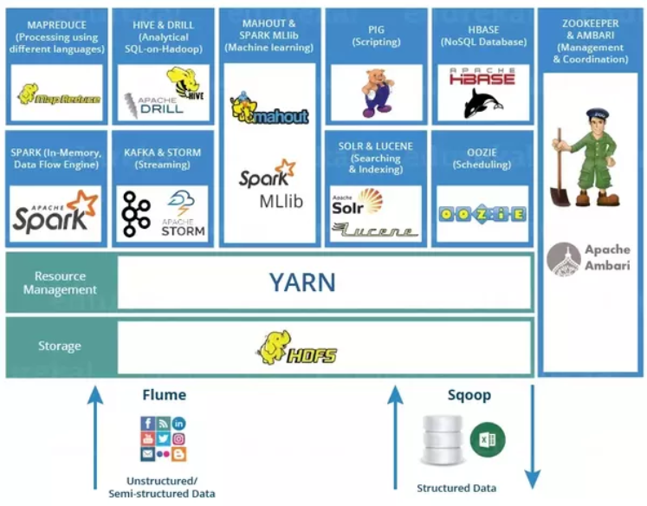




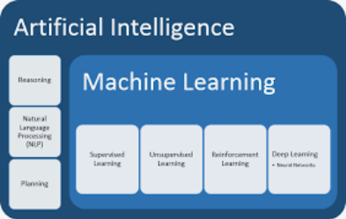
Introduction to Data Science
Data science tool

Slide 8


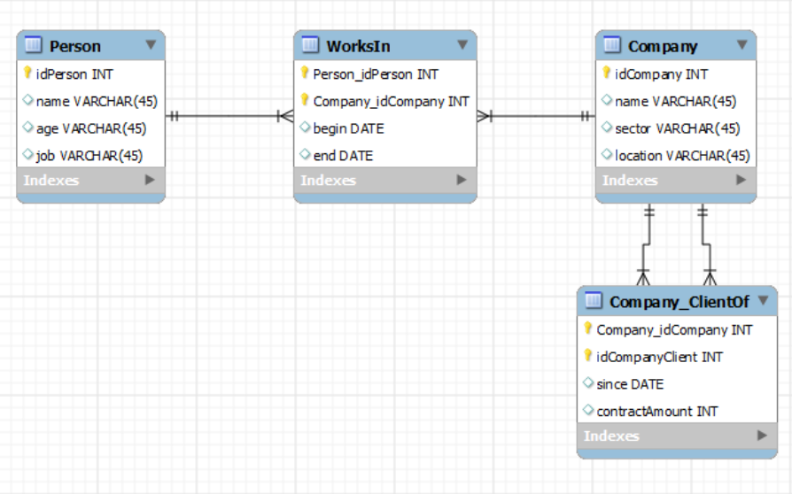
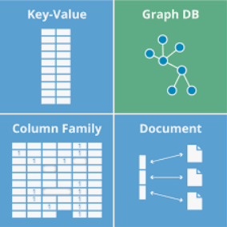

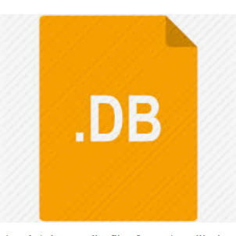
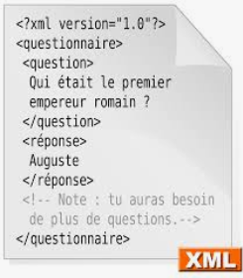
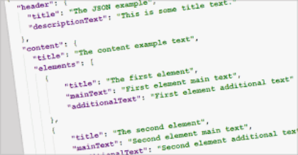
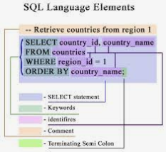
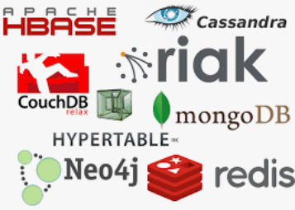
3. Data science steps 1. Acquiring Data
SQL DB
NOSQL DB
Files

Slide 9
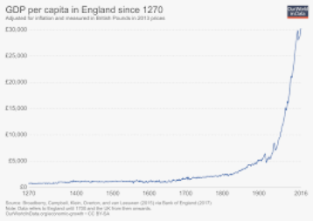
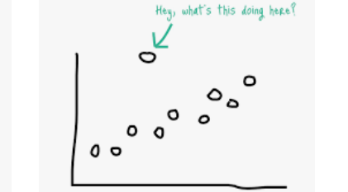
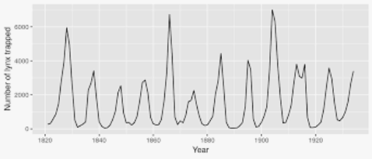
3. Data science steps 2. Exploring Data
Outliers
General trends

Slide 10
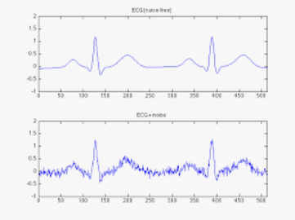
3. Data science steps 3. Preprocessing Data
Clean
Duplicate records
Missing values
Invalid data
Outliers
Transform
Scaling
Denoizing
Feature Selection
Combine
Remove
Dimensionnal
Notes:
Scaling : taille/ poid
Feature selection :
Post code / town
1 post code -> several town
Remove post code?
Dimensionnal
draw a graph in 3d :
age/ income/ level of education

Slide 11
3. Data science steps 4. Analyse Data
Clustering
In general, Clustering tries to group a set of objects and find whether there is some relationship between the objects.
In the context of machine learning, classification is supervised learning and clustering is unsupervised learning.
Classification
The goal is to predict the category of the input data. (binary or not) For example:
pregnant/ Not pregnant
handwritten digit
Regression
your model has to predict a numeric value instead of a category then the task becomes a regression problem.
association analysis
It is a means to discover relationships in large data sets. Beer-diaper example

Slide 12
Numpy introduction
http://www.numpy.org/
https://github.com/vuillaut/datascience-courses
Notes:
conda env create -f environment.yml
Conda lenvs list
Conda activate
Jupyter notebook

